Slide 1
FASHION - MNIST
CLOTHING CLASSIFICATION
Under Supervision of :
Dr. Ankit Rajpal
By:-
Aditya Sethi (07), Paras Kumar(37), Ronit Kumar(48)

Slide 2
PROJECT OVERVIEW
METHODOLOGY
PROBLEM STATEMENT
RELATED WORK
DATASET OVERVIEW
MODEL SELECTION
MODEL EVALUATION
RESULT
CONCLUSION
REFERENCES

Slide 3
METHODOLOGY
1. PROBLEM FORMULATION
2. RELATED WORK
3. MODEL SELECTION
4. DATASET OVERVIEW
5. TRAINING AND EVALUATION
6. ANALYSIS AND COMPARISON

Slide 4
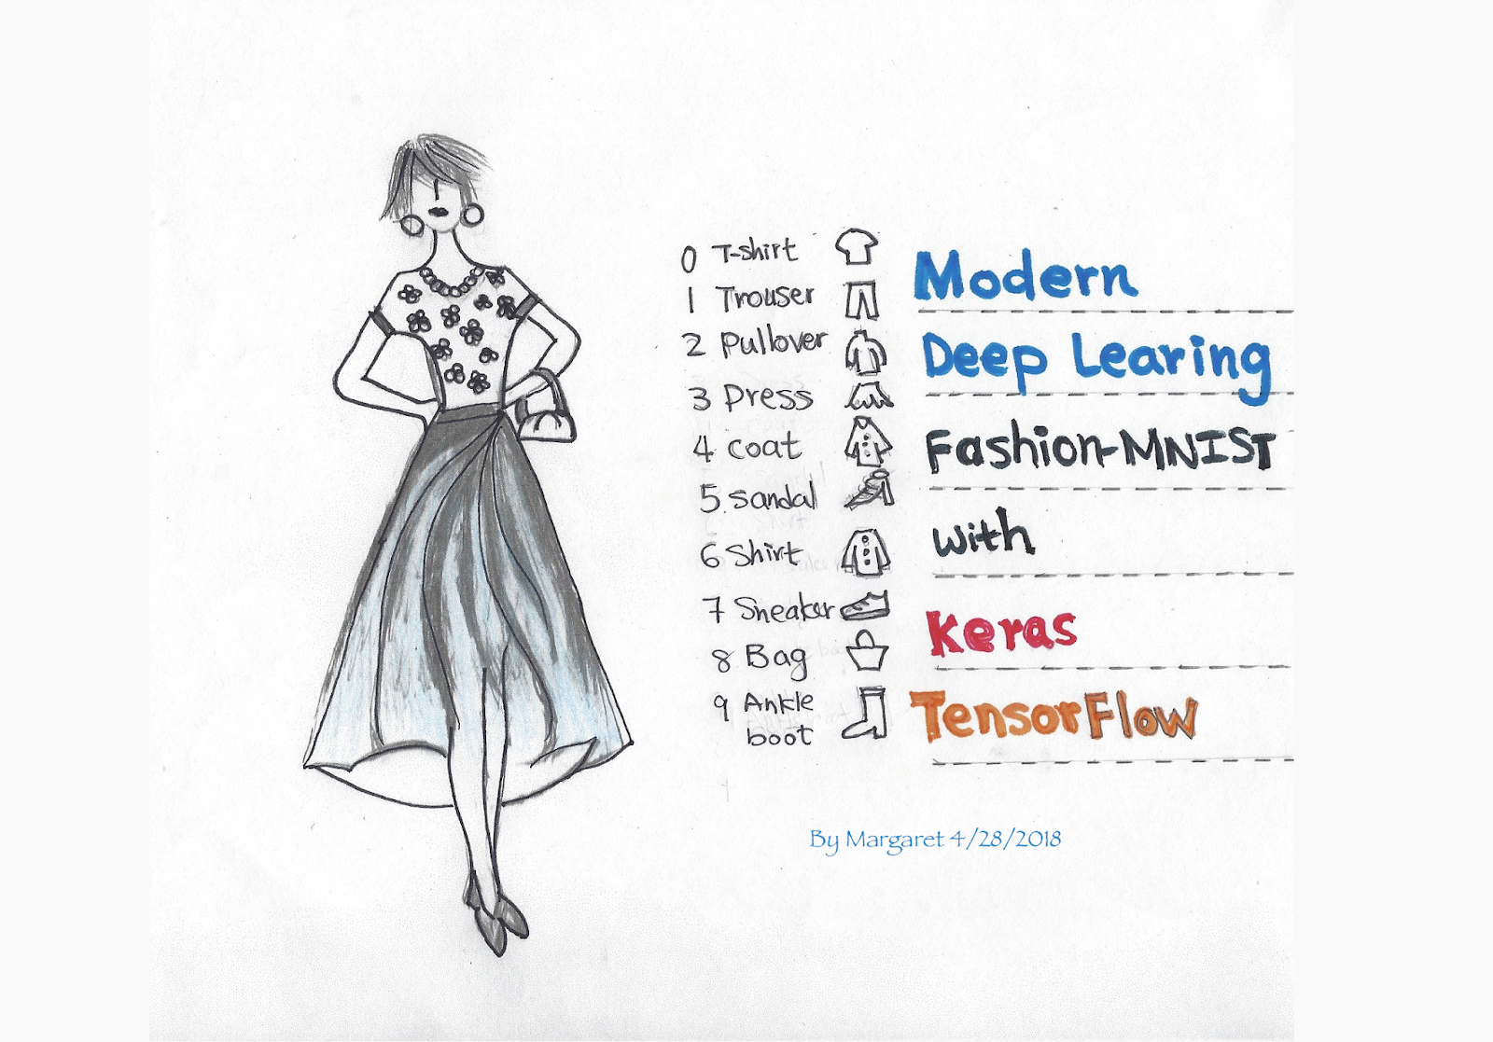
PROBLEM STATEMENT
In the fast-paced fashion industry, efficient and accurate image classification is crucial for various applications such as trend analysis, product recommendation, and inventory management.
Therefore, there is need to develop a robust and scalable image classification model tailored specifically for the fashion industry. This model should effectively classify fashion images into relevant categories such as clothing types, patterns, colors, and styles, while also accommodating variations in lighting, poses, and backgrounds.
Additionally, it should be capable of exhibiting high accuracy, scalability, and computational efficiency to meet the demands of real-world fashion applications.
REF : https://blog.tensorflow.org/2018/04/fashion-mnist-with-tfkeras.html

Slide 5
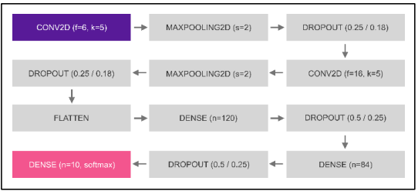
RELATED WORK
PAPER 1 - Valderi Reis Quietinho Leithardt, Anita Maria Rocha Fernandes, Sérgio Correia, Rodrigo Lyra, “Classifying Garments from Fashion-MNIST Dataset Through CNNs”, in Advances in Science Technology and Engineering Systems Journal, February 2021. DOI: 10.25046/aj0601109. [2]
PROPOSED MODELS :
CNN dropout-1 and CNN dropout-3 : Both models use two consecutive blocks containing: a convolution, a max pooling, and finally a drop out. These blocks are connected to two more fully connected layers, who are connected to an output layer of ten neurons, each one representing a category.
The only difference between these two models is that cnn-dropout-3 has considerably lower dropout values

Slide 6
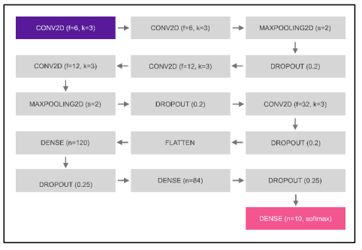
2. CNN dropout -2 :
This proposed model is very similar to the cnn-dropout-1 model. However, it has two layers of convolutions before each max pooling.

Slide 7
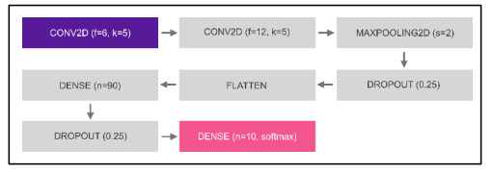
3. CNN SIMPLE : Cnn-simple is a model with less layers. It has only two convolutions, followed by a fully connected layer, in addition to the respective dropout and max pooling like other models.

Slide 8
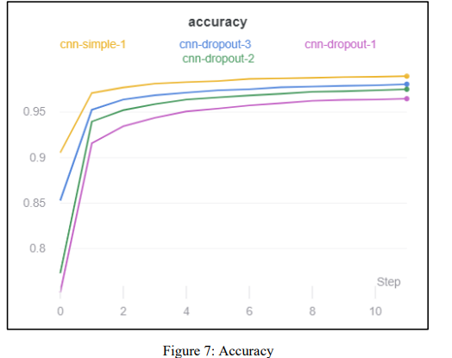
RESULTS
On the training dataset, the most accurate model was CNN Simple, with 98.95% of accuracy.
Other models were also acceptable, based on the results obtained: 98.06% (CNN-dropout-3), 97.51% (CNN-dropout-2), and even the worst model (CNN-dropout-1), got an accuracy of 96.46%
MODEL | ACCURACY
CNN SIMPLE | 98.95
CNN- DROPOUT-3 | 98.06
CNN - DROPOUT-2 | 97.51
CNN - DROPOUT-1 | 96.46

Slide 9
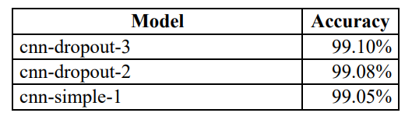
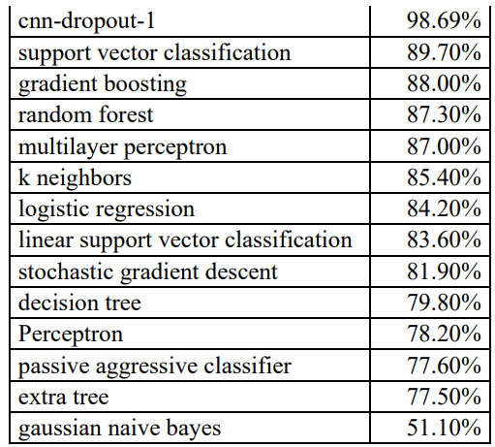
Further they compared the result of their models with the traditional non-convolutive machine learning algorithms
Results shows that even their worst results (cnn-dropout-1) got better result than previously proposed algorithms

Slide 10
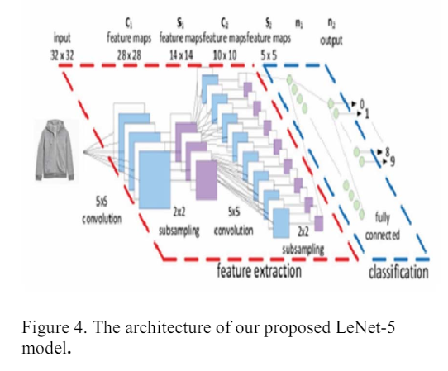
PAPER 2 - M. Kayed, A. Anter and H. Mohamed, "Classification of Garments from Fashion MNIST Dataset Using CNN LeNet-5 Architecture," in 2020 International Conference on Innovative Trends in Communication and Computer Engineering (ITCE), Aswan, Egypt, 2020, pp. 238-243, DOI: 10.1109/ITCE48509.2020.9047776.
PROPOSED MODEL :
In this paper, the author uses the last LeNet-5 for Fashion-MNIST image classification. It was used because it is simple and gives high-performance results in several domains. It is built on local receptive fields, shared weights and special subsampling.

Slide 11
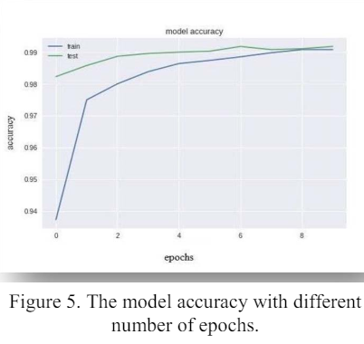
RESULTS
A comparison between LeNet-5 and the other classification models on Fashion MNIST dataset.
Model(Method) | Test Accuracy
Three-layer Neural Network | 87.23%
CNN using SVM activation function | 90.72%
CNN using Softmax activation function | 91.86%
KNeighborsClassifier | 85.40%
Decision Tree Classifier | 79.80%
RandomForestClassifier | 87.30%
CNN-LeNet-5 | 98.80%

Slide 12
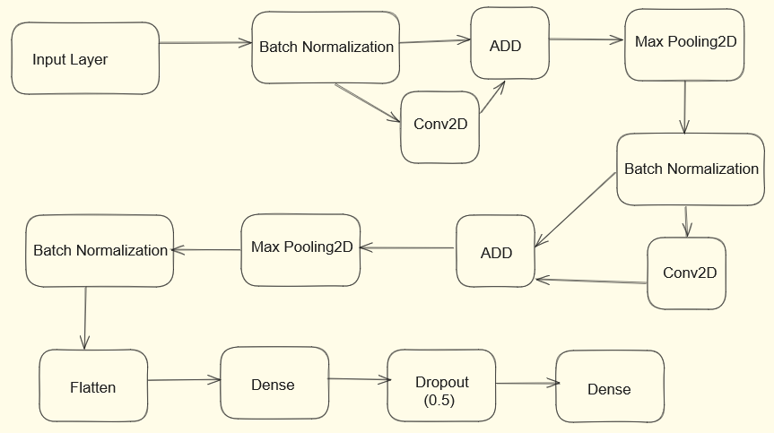
PAPER 3 - S. Bhatnagar, D. Ghosal and M. H. Kolekar, "Classification of fashion article images using convolutional neural networks," 2017 Fourth International Conference on Image Information Processing (ICIIP), Shimla, India, 2017, pp. 1-6, doi: 10.1109/ICIIP.2017.8313740.
PROPOSED MODEL :
2 Convolutional and max pooling layers one after the other. Each convolutional layer has 32 filter of size 3x3, and max pooling were performed on every 2x2 pixels.
Batch Normalization was done before every convolutional layer to improve the training speed of the model. With Batch Normalization we were able to achieve the same loss function value after 10 epochs which was achieved after 40 epochs without Batch Normalization.
Residual Skip : we add the previous input and current value of convoluted output to get the final output.

Slide 13
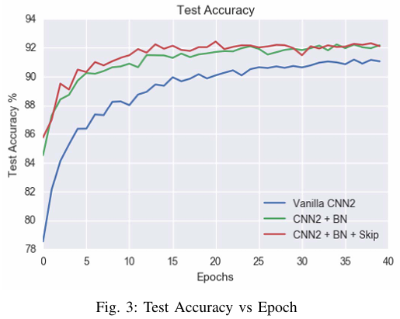
RESULTS
Comparison between SVC with rbf kernel and the other classification models on Fashion MNIST dataset.
Model(Method) | Test Accuracy
SVC C = 10; kernel : rbf | 89.70%
CNN2 | 91.17%
CNN2 + BatchNorm | 92.22%
CNN2 + BatchNorm + Skip | 92.54%
CONCLUSION : We were able to achieve an accuracy of 92.54% by using a two layer CNN along with Batch Normalization and Skip Connections. We can clearly see how Batch Normalization and Skip Connections help improve the overall accuracy and significantly reduce the training time.

Slide 14
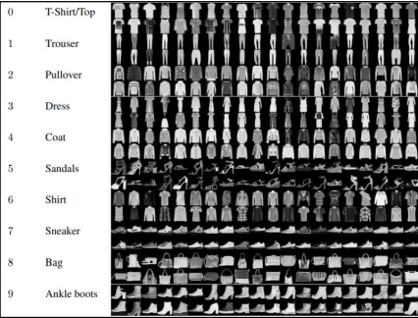
DATASET OVERVIEW
DATA SET USED :
Fashion-MNIST is a direct drop-in alternative to the original MNIST dataset, for benchmarking machine learning algorithms . MNIST is a collection of handwritten digits, and contains 70000 greyscale 28x28 images, associated with 10 labels, where 60000 are part of the training set and 10000 of the testing. Fashion-MNIST has the exact same structure, but images are fashion products, not digits.
A sample of this set is presented as follows : -
Ref : https://www.kaggle.com/datasets/zalando-research/fashionmnist

Slide 15

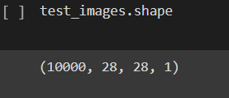
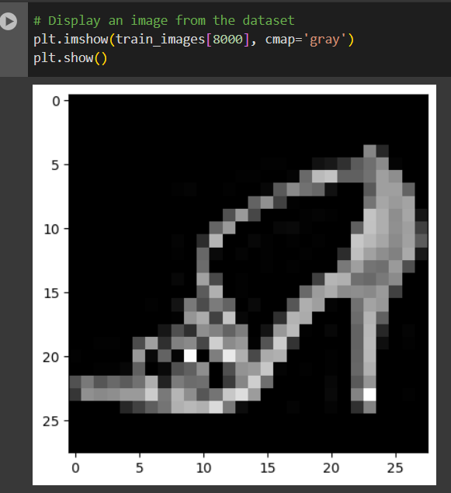
Train Image shape :
Test image Shape :
Normalizing data : Normalizing the dataset to bring all the input features to a similar scale :
Displaying an image from Dataset :

Slide 16
MODEL SELECTION
To obtain results for classification, 3 different CNN models were analyzed in python with Tensorflow and Keras. Collab Notebook was used for training using GPU-4.
Proposed Models are :
CNN - SIMPLE
CNN WITH DROPOUT
LENET 5 MODEL

Slide 17
CNN- SIMPLE
Cnn-simple is a model with less layers. It has only two convolutions, followed by a fully connected layer.
CONV2D
(32 FILTERS, 3X3)
MAXPOOLING 2D
(POOL SIZE 2X2)
CONV2D
(64 FILTERS, 3X3)
INPUT IMAGE
(28X28X1)
The first layer is a 2D convolutional layer (Conv2D) with 32 filters of size 3x3.
It applies a convolution operation to the input, extracting features using these filters.
The second layer is a max-pooling layer (MaxPooling2D) with a pool size of 2x2.
The third layer is another 2D convolutional layer with 64 filters of size 3x3, followed by a ReLU activation.
FLATTENING LAYER
MAXPOOLING 2D
(POOL SIZE 2X2)
DENSE LAYER
(10 UNITS)
DENSE LAYER
(64 UNITS)
The second dense layer has 10 units with softmax activation. It produces the output probabilities for all 10 classes.
first dense layer has 64 units with ReLU activation. It learns complex patterns in the data.
The feature maps are flattened into a 1D vector using the Flatten layer. This prepares the data for input into the fully connected layers.
The fourth layer is another max-pooling layer.

Slide 18
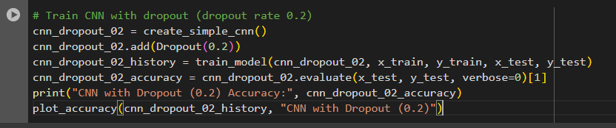
CNN WITH DROPOUT
Dropout works by probabilistically “dropping out,” inputs to a layer, which may be input variables in the data sample or activations from a previous layer.
Dropout 0.2 suggests to keep 80% and set 20% of the inputs to 0.
We tested Dropout of 0.2 and 0.1.

Slide 19
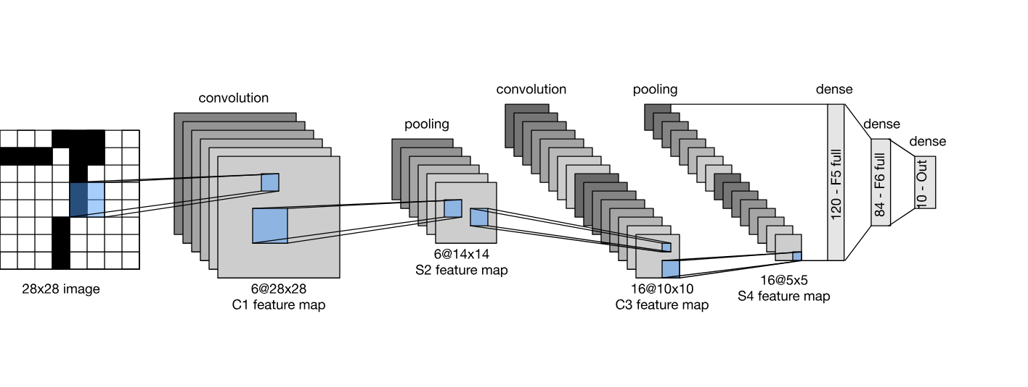
LENET - 5 MODEL
In LeNet - 5, there are 7 layers in total.
2 Convolutional layers with filter size of 5x5 and stride of 1 also with ReLU activation
2 Average pooling layers with filter size of 2x2
2 fully connected layers with ReLU activation and
1 output layer with softmax activation.
Image Ref : https://d2l.ai/chapter_convolutional-neural-networks/lenet.html

Slide 20
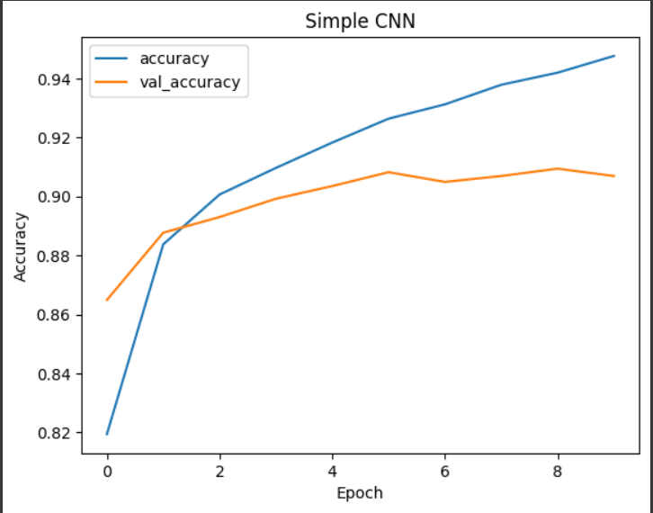
MODEL EVALUATIONS
RESULT WITH SIMPLE CNN
Accuracy | 90.68
Epochs | 10
Batch Size | 32

Slide 21
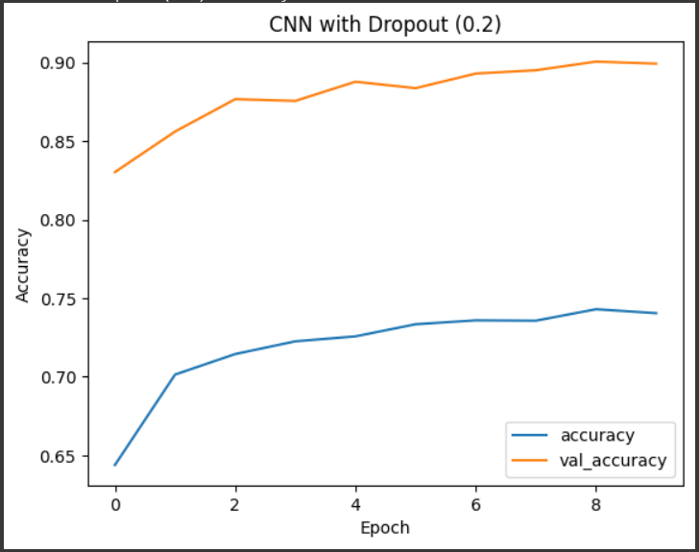
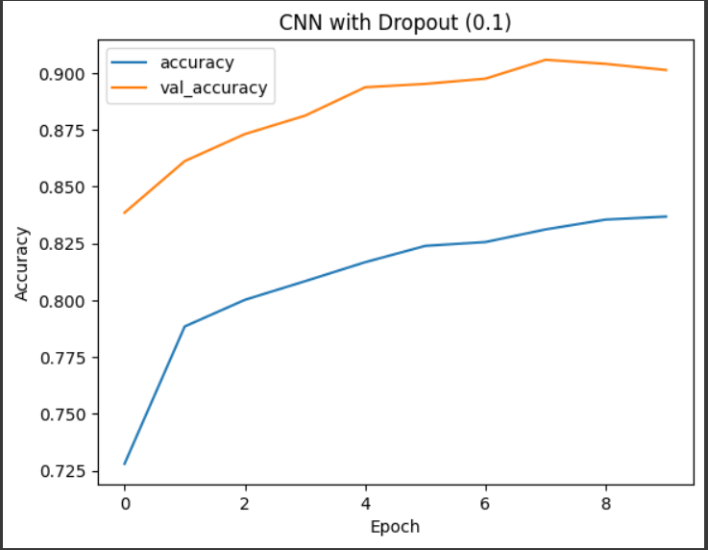
MODEL EVALUATIONS
RESULT WITH CNN DROPOUT
Dropout | 0.2 | 0.1
Accuracy | 89.9 | 90
Epochs | 10 | 10
Batch Size | 32 | 32

Slide 22
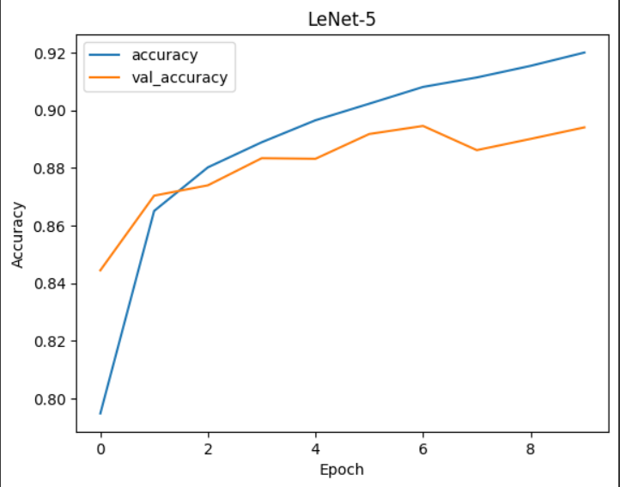
MODEL EVALUATIONS
RESULT WITH CNN LeNet-5
Accuracy | 91.9
Epochs | 10
Batch Size | 32

Slide 23
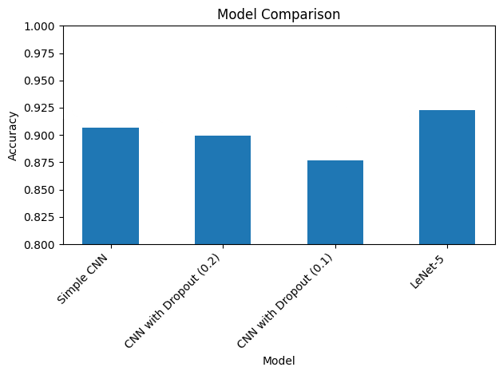
FINAL RESULT
COMPARISON BETWEEN ALL 3 MODELS
MODELS | ACCURACY | EPOCHS | BATCH SIZE
SIMPLE CNN | 90.68 | 10 | 32
CNN WITH DROPOUT 0.1 | 90 | 10 | 32
CNN WITH DROPOUT 0.2 | 89.9 | 10 | 32
LE-NET 5 | 91.9 | 10 | 32

Slide 24
CONCLUSION AND FUTURE SCOPE
With the growth in deep learning methodologies, image recognition using CNN is excessively applied in fashion domains such as clothes classification, clothes retrieval and automatic clothes labeling.
In this project, we applied 3 models named Simple CNN, CNN with Dropout(0.1 & 0.2) and LeNet-5 on the Fashion MNIST dataset. LeNet-5 gave the highest performance (an accuracy over 91.1% was obtained) as compared to other models.
We plan to apply LeNet-5 and other CNN models on a dataset of real clothes images collected by ourself for the evaluation purposes.

Slide 25
REFERENCES
M. Kayed, A. Anter and H. Mohamed, "Classification of Garments from Fashion MNIST Dataset Using CNN LeNet-5 Architecture," in 2020 International Conference on Innovative Trends in Communication and Computer Engineering (ITCE), Aswan, Egypt, 2020, pp. 238-243, DOI: 10.1109/ITCE48509.2020.9047776.
Valderi Reis Quietinho Leithardt, Anita Maria Rocha Fernandes, Sérgio Correia, Rodrigo Lyra, “Classifying Garments from Fashion-MNIST Dataset Through CNNs”, in Advances in Science Technology and Engineering Systems Journal, February 2021. DOI: 10.25046/aj0601109.
Krizhevsky, A., Sutskever, I., & Hinton, G. E. (2012). Imagenet classification with deep convolutional neural networks. In Advances in neural information processing systems (pp. 1097-1105).
K V, Greeshma & Sreekumar, K.. (2019). Fashion-MNIST classification based on HOG feature descriptor using SVM. International Journal of Innovative Technology and Exploring Engineering. 8. 960-962.
https://blog.tensorflow.org/2018/04/fashion-mnist-with-tfkeras.html
https://pyimagesearch.com/2016/08/01/lenet-convolutional-neural-network-in-python/

Slide 26
THANK YOU
ADITYA SETHI
PARAS KUMAR
RONIT KUMAR
MSC COMPUTER SCIENCE
DEPARTMENT OF COMPUTER SCIENCE
UNIVERSITY OF DELHI

